Slide 1
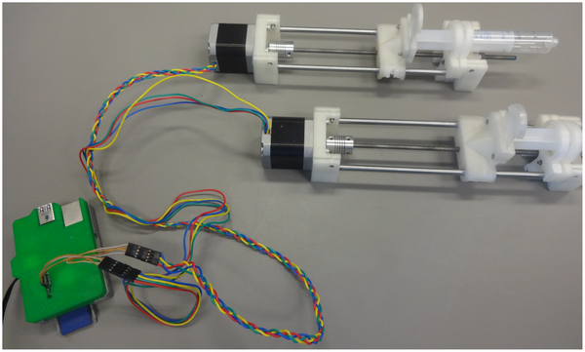

Figure 6. Digital Photograph of Open-Source Syringe Pump version of the Dual Nema 17 Pump.
Wijnen B, Hunt EJ, Anzalone GC, Pearce JM (2014) Open-Source Syringe Pump Library. PLOS ONE 9(9): e107216. https://doi.org/10.1371/journal.pone.0107216
https://journals.plos.org/plosone/article?id=10.1371/journal.pone.0107216

